Slide 1


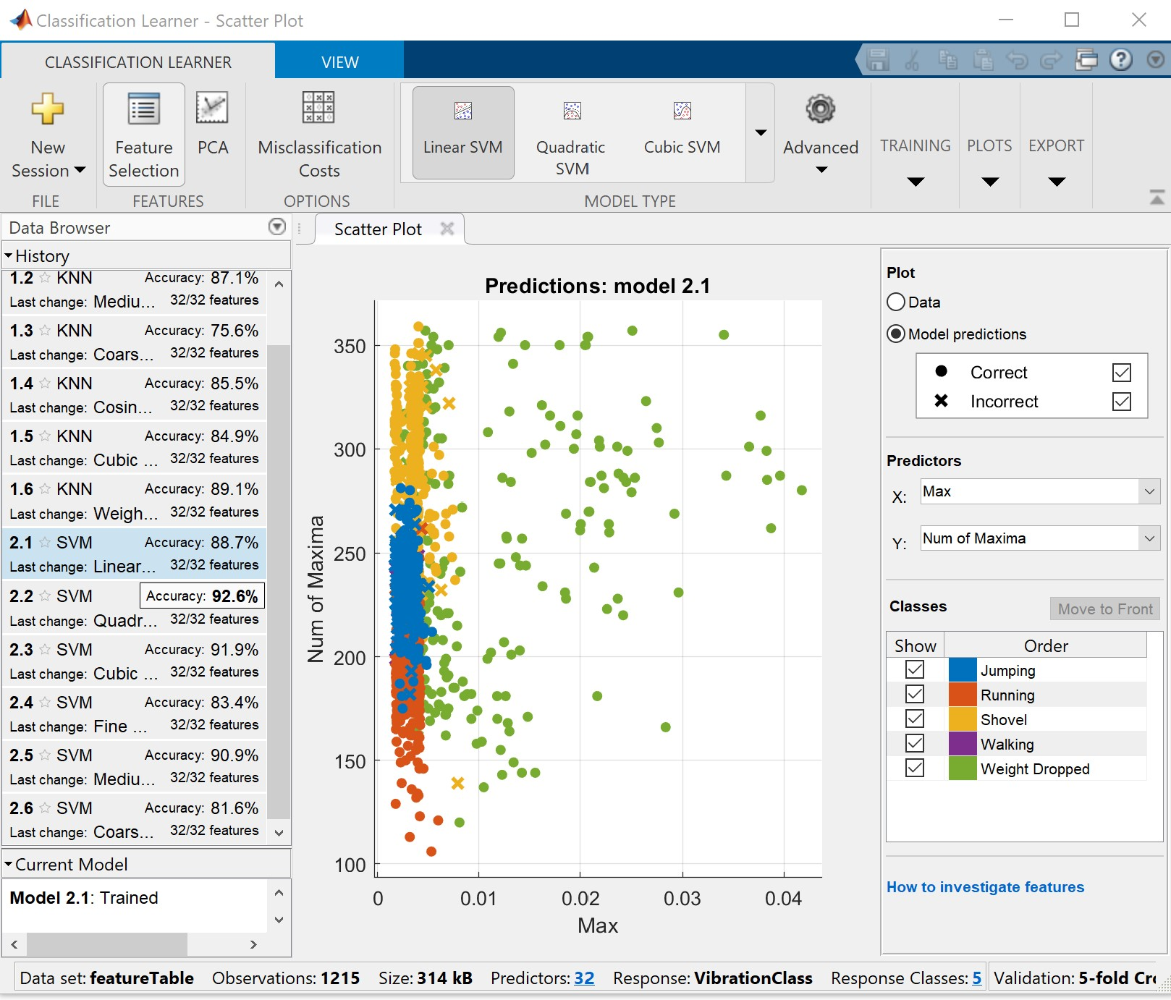
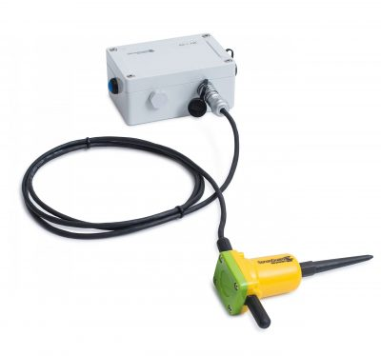
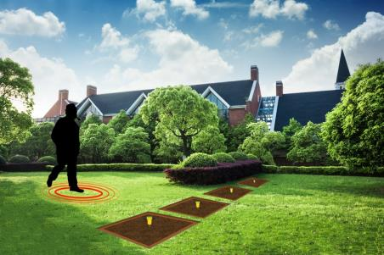
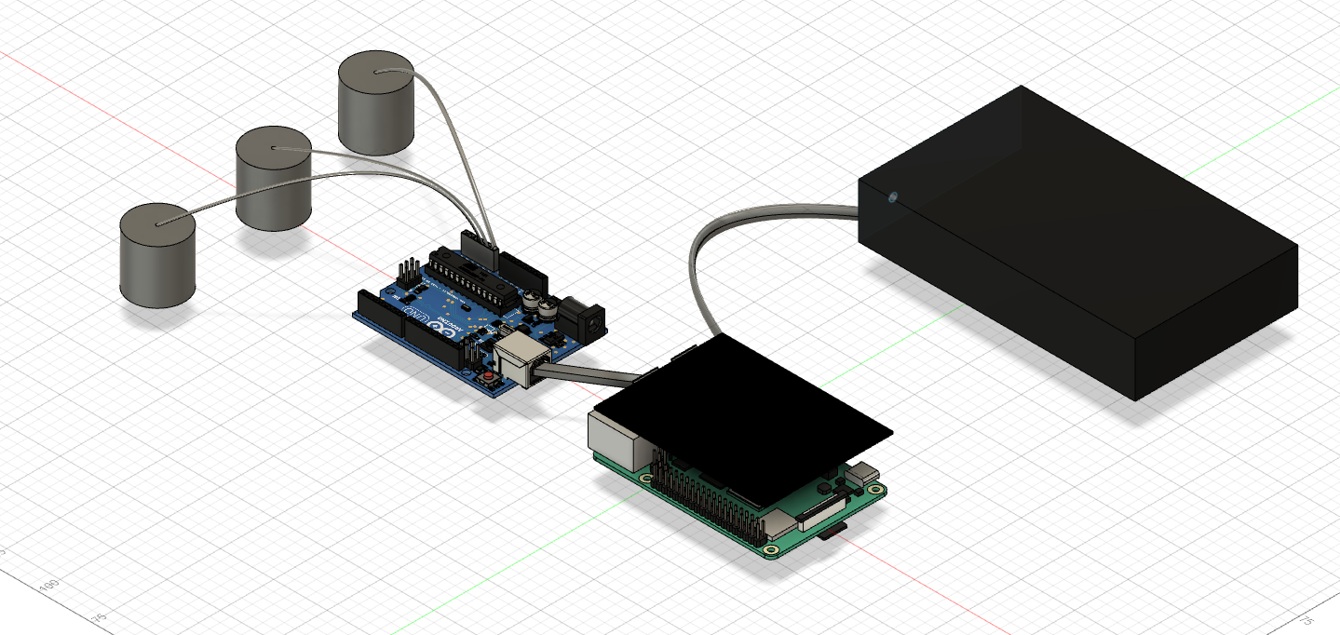
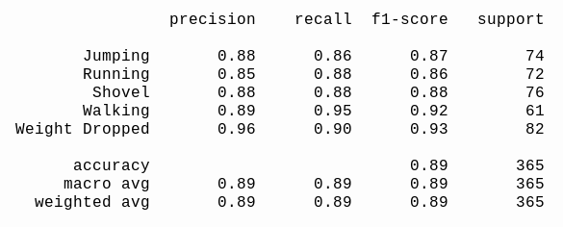
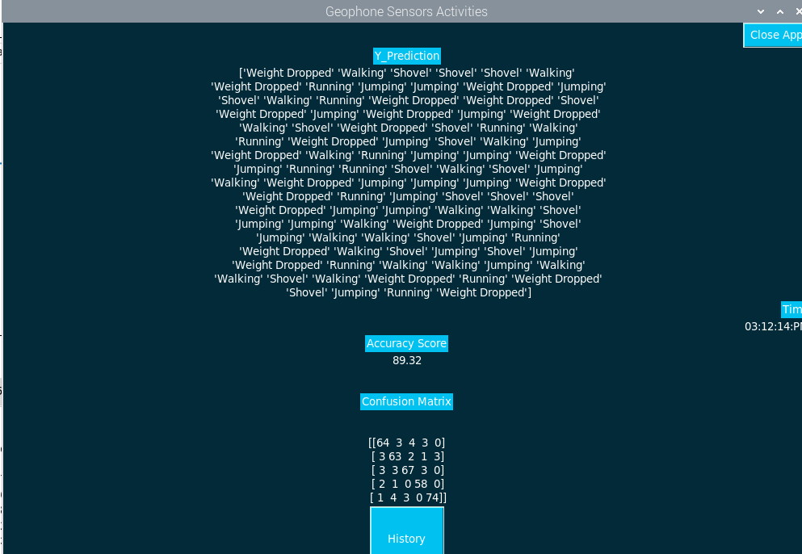
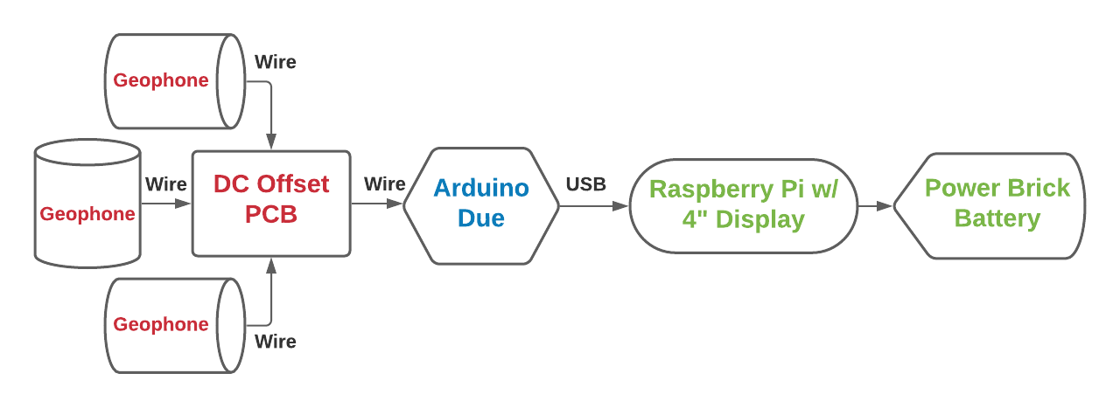
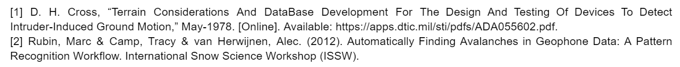
System of Networked Sensors for Detection and
Characterization of Underground Activity Augustus Standeven, Tyler McKean, Vulindsky Fanfan, Yohannes Kidane
Department of Engineering – University of Massachusetts Boston
Underground Detection Systems
MOTIVATION
DESIGN VALIDATION
MATLAB Classification Learner verified KNN model’s accuracy will be 80-85%
Python’s individual accuracy for 5 different class of vibrations
Commercial systems are expensive, complex, time consuming to setup, and can be difficult to interpret.
Goal: Create a system that is portable, cheap, easy to setup, and user-friendly with intentions that project could be scaled up for another Design team in the future.
The system is mainly composed of three parts:
Geophone Sensors with DC Offset PCB
Passive Vibration sensors will be offset by 1.65V to capture peaks and troughs of oscillations.
Arduino Due
12-bit Resolution for Analog-to-Digital Conversion
Serial communication via USB port to Rpi for data logging.
Raspberry Pi
Data logging of Serial data from Arduino.
Python scripts that Preprocess logged data and Extracts Statistical and Analytical Features that are imported into a KNN Machine Learning Model.
Displays predictions of Vibrations to GUI, which includes History tab for previously occurred events.
Power Brick Battery
Provides 12V 6000mAh/5V USB DC voltage
GUI displays 89% accuracy for 1200 observations of 5 vibration classes
DESIGN DESCRIPTION
Networked Sensors System featuring:
Low Cost, Portable, Minimal Size, and Weight system that’s simple to setup
Machine Learning model trained for 5 different vibration classes with an accuracy range of 80-90%
GUI displaying Accuracy and History of Predictions to Rpi 4” LCD screen
Power Brick Battery that can self-power system for about 10-11 hours
Project could be expanded by scaling up number of sensors, including filtering/amplifiers to sensors, and increasing signal library to train model to classify more vibration sources
FINAL PRODUCT, CONCLUSIONS & FUTURE PLAN
PROJECT DEFINITION
Data Acquisition
Geophone sensors to capture ground vibrations
PCB to acquire full oscillation information
Arduino Due
Analog-to-Digital Conversion
Raspberry Pi
Data Logging, Processing, and Display Results to Display
Power Brick Battery daisy-chains power to components
References
4/14/21
Acknowledgements:
Our group would like to acknowledge the input and support of our CM: William Shepherd and TM: Dr. Tomas Materdey

